Slide 1
AI Airlift - Designing Intelligent Apps and Agents
Rodrigo Souza
Applied Data Scientist
LearnAI Team / Cloud & AI
Vinod Kurpad
Principal Program Manager
Applied AI / Cloud & AI

Slide 2
Wi-Fi
SSIDs: Marriot_Public or Microsoft
Password: not required

Slide 3
LearnAI Team – learnai@microsoft.com http://aka.ms/LearnAI-Portal http://aka.ms/LearnAI-GitHub http://aka.ms/LearnAI-Links This Training http://aka.ms/LearnAI-Airlift

Slide 4
This Training http://aka.ms/LearnAI-Airlift LearnAI Airlift = CSB + KMB
50% 50%
Original 2 Days 2 Days
Airlift version 1.5 D 1.5 D

Slide 5
This Training http://aka.ms/LearnAI-Airlift CSB http://aka.ms/LearnAI-csb KMB http://aka.ms/LearnAI-kmb

Slide 6
Training Goals – What Will You Learn
CSB
Computer Vision
Custom Vision
LUIS
Azure Search
Bot
Bing Search
KMB
Azure Search
Cognitive Search
Azure Functions
Content Moderator
Bot
Poll

Slide 7
Training Goals – What Will You Learn
CSB
Computer Vision
Custom Vision
LUIS
Azure Search
Bot
Bing Search
KMB
Azure Search
Cognitive Search
Azure Functions
Content Moderator
Bot
Basic Tier

Slide 8
Training Goals – What Will You Learn
CSB
Computer Vision
Custom Vision
LUIS
Azure Search
Bot
Bing Search
KMB
Azure Search
Cognitive Search
Azure Functions
Content Moderator
Bot
Complex
Simple

Slide 9
Training Goals – How Will You Learn
Presentations
Hands-On Labs to Build E2E Applications
CSB = Intelligent Search
KMB = Cognitive Search

Slide 10
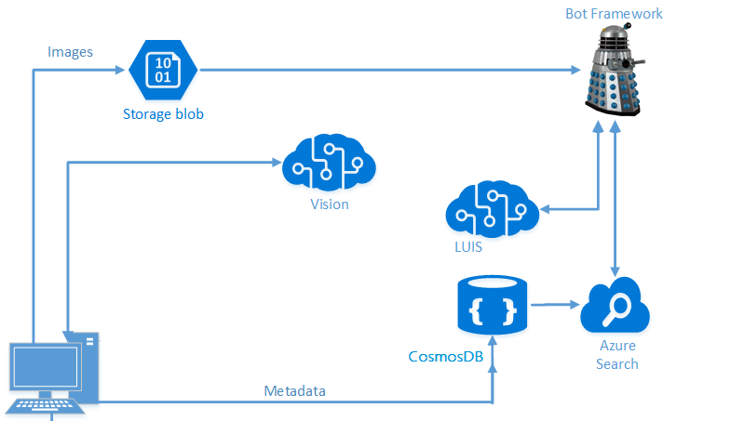
Architecture – Intelligent Search

Slide 11
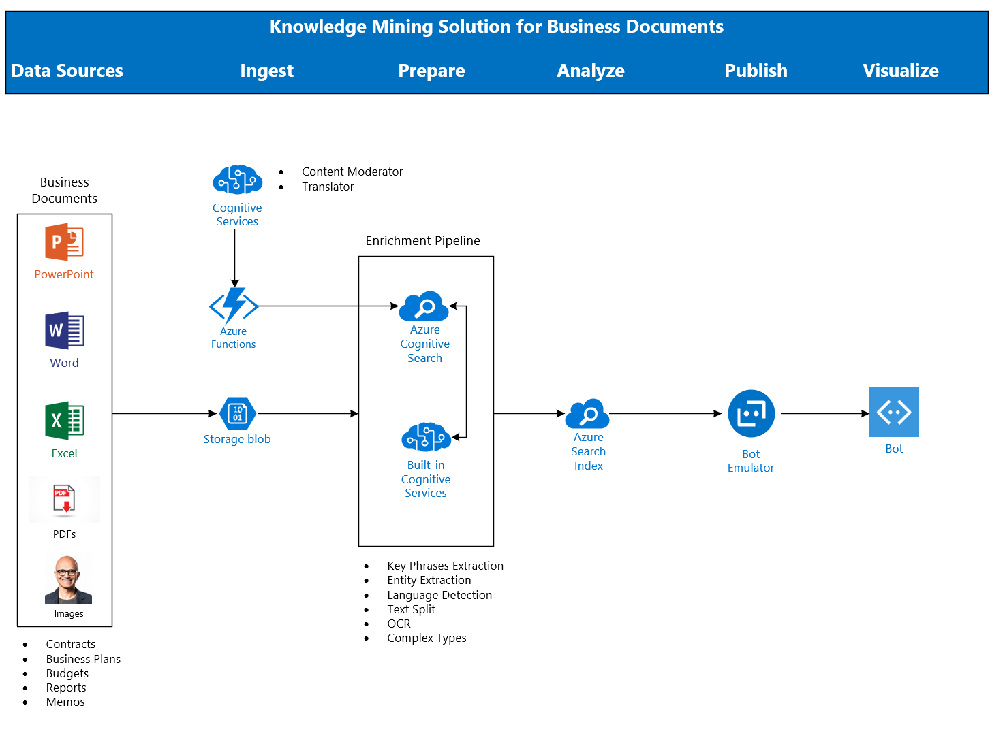
Architecture - Cognitive Search

Slide 12
Housekeeping
Restrooms
Office Hours
Survey

Slide 13
Housekeeping
Morning Tea = 10:30 AM – 10:45 AM
Lunch = 12 PM – 1 PM
Afternoon Tea = 2:45 PM – 3 PM

Slide 14
Spektra Environment
Azure Account
DSVM
Deployed Services: storage account, CosmosDB, Computer Vision API
Azure Search should be created in the same region of the DSVM

Slide 15
Spektra Environment
http://aka.ms/LearnAI-Spektra-cs
Confirmation email from noreply@cloudlabs.ai

Slide 16
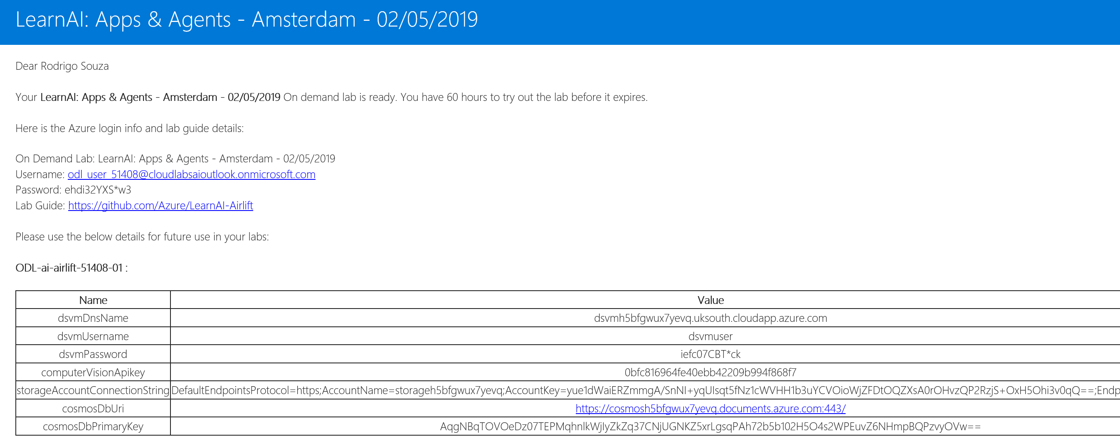
Spektra Environment

Slide 17
Breaking News
Container support in Azure Cognitive Services
https://docs.microsoft.com/en-us/azure/cognitive-services/cognitive-services-container-support
Power BI delivers AI power
https://www.zdnet.com/article/power-bi-delivers-ai-power/
New Certifications! Beta for a limited time!
Azure Data Engineer
Azure AI Engineer
Azure Data Scientist
https://www.microsoft.com/en-us/learning/browse-new-certification.aspx

Slide 18
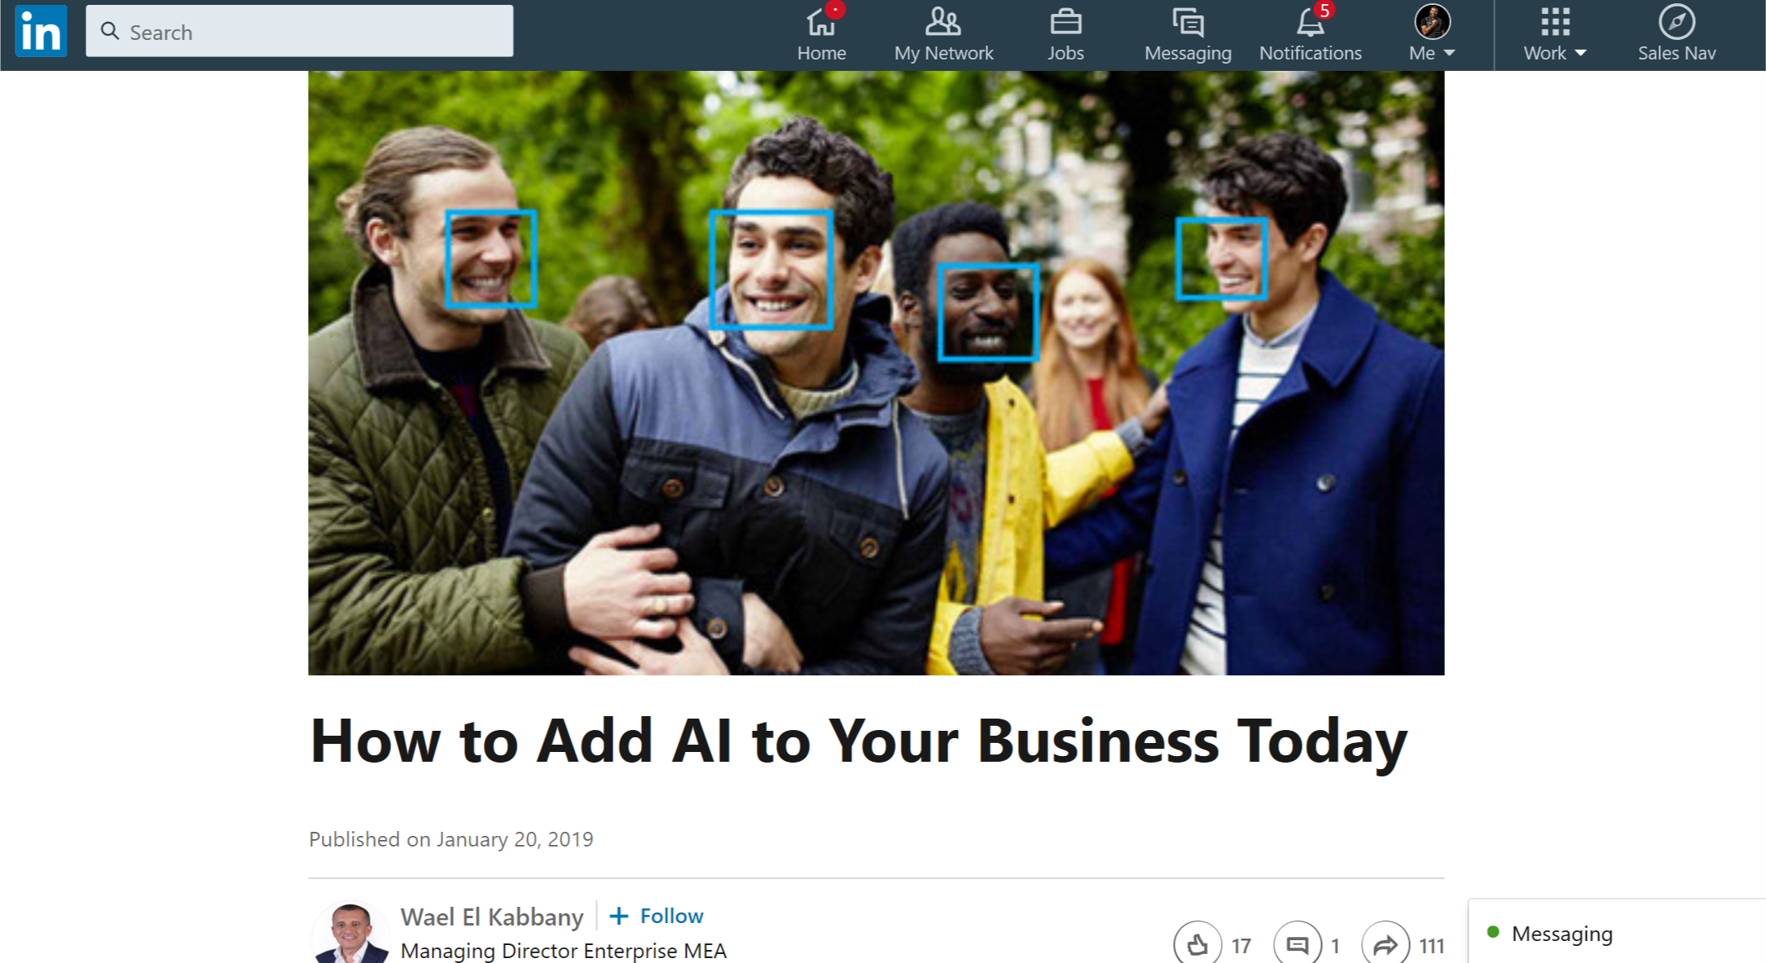
More News
https://www.linkedin.com/pulse/how-add-ai-your-business-today-wael-el-kabbany/

Slide 19
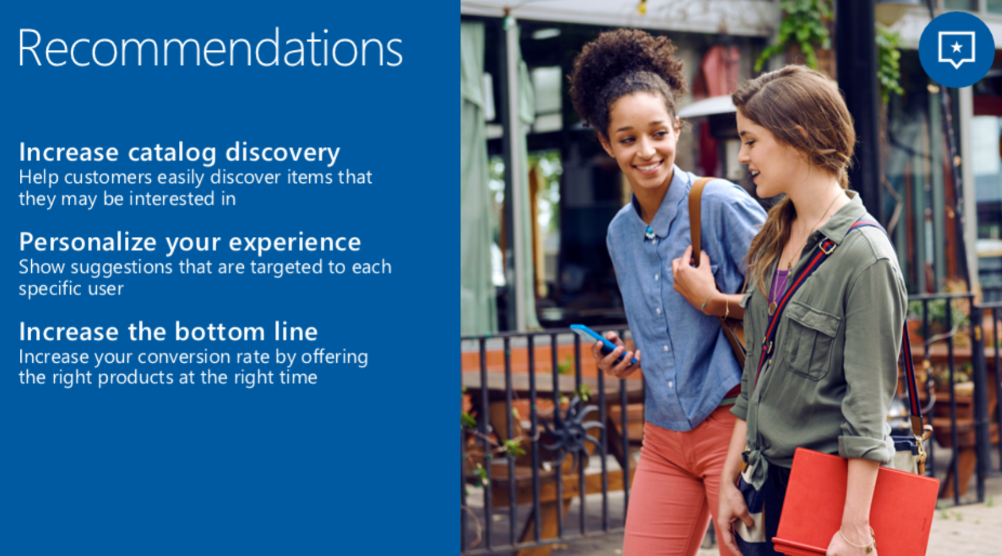
Breaking News

Slide 20
Breaking News
Going to Private Preview – Invitation Only
Personalization and Optimization
Based on Reinforcement Learning
Learns from the real world based on feedback
Don’t need to label the data
Don’t need to train your model
AI suggests and you give a feedback, over and over
Used in Xbox, Bing, Office, Azure, Windows, Skype.
Now available to any developer.

Slide 21
Let’s go! http://aka.ms/LearnAI-Airlift

Slide 22
Thank you! LearnAI Team – learnai@microsoft.com http://aka.ms/LearnAI-Portal http://aka.ms/LearnAI-GitHub http://aka.ms/LearnAI-Links

Slide 23
Backup Slides

Slide 24
Tomorrow
Sign the presence sheet
Photo
Demos (including the training bot)
Survey
http://aka.ms/LearnAI-Airlift-Survey

Slide 25
Demos
Forms Understanding
AI Sandbox

Slide 26
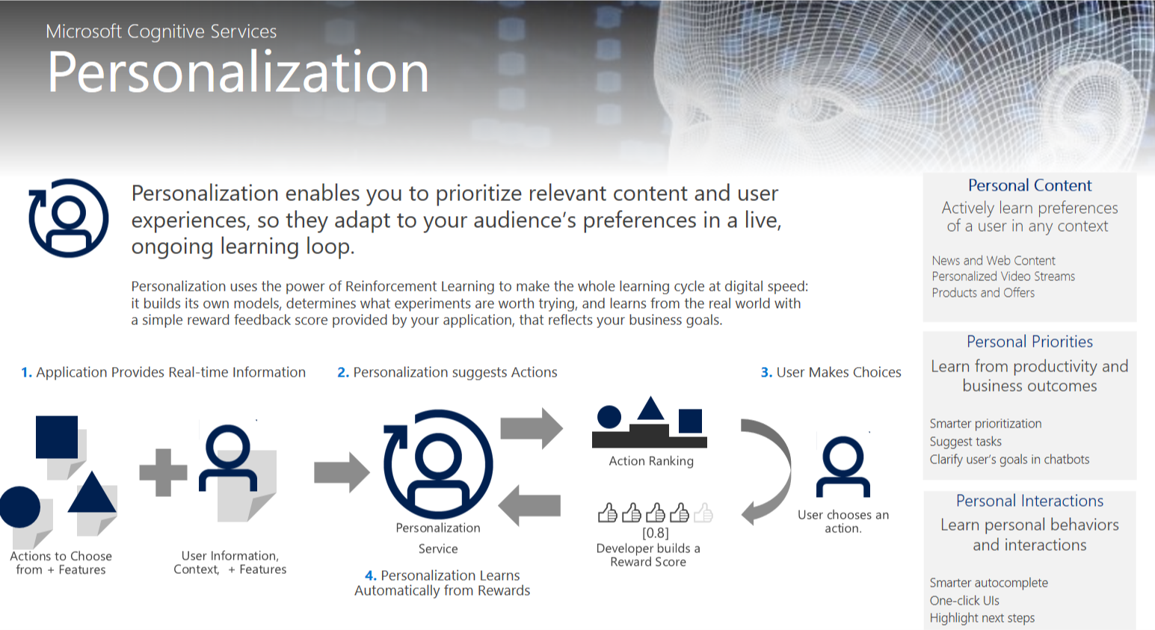
Breaking News

Slide 27
Lunch: 12 – 1 PM
KMB: 1 PM – 6 PM
http://aka.ms/LearnAI-kmb

Slide 28
Links
http://aka.ms/LearnAI-Links
Suggestions, Feedback, Redeliveries
learnai@microsoft.com
rosouz@microsoft.com
Thank you!!

Slide 29
Survey!!
http://aka.ms/LearnAI-Airlift-Survey
Suggestions, Feedback, Redeliveries
learnai@microsoft.com
rosouz@microsoft.com
Thank you!!

Slide 30
Rodrigo Souza
rosouz@micrsosoft.com

Slide 31
Custom Vision URLs
https://docs.microsoft.com/en-gb/azure/cognitive-services/custom-vision-service/getting-started-build-a-classifier
http://customvision.ai

